Slide 1
Salary Predictions of Data Science Roles

Slide 2
Why Data Science Salaries?
We selected this topic because it was one that was of interest to all of us. As we graduate from this course and enter the job market we have a frame of reference when negotiating offers.
Our goal throughout this analysis was to better educate us on the salary levels of different data-related jobs.
We wanted to see how factors such as company, location and experience affect the expected salary.

Slide 3
Our Data
The dataset we selected to use is:
Kaggle: Salary and more-Data Scientist, Analyst, Engineer, Retrieved 3/16/2022 from https://www.kaggle.com/jackogozaly/data-science-and-stem-salaries.
Some of the data this dataset includes are job title, salary, company, years of experience, gender, education level and location
During our analysis, we hoped this dataset would help us answer the question of how do different factors such as location, years of experience, gender, and company affect the anticipated salary?

Slide 4
Exploration of Data
Imported data in csv form into a Jupyter notebook and cleaned the data using pandas:
Dropping unnecessary columns in Data Frame, such as
Split the location into States, Cities and Countries
Use Drop Na function to remove the empty columns
Bin Companies and States(?) by data count size
HotEncoder all the object column
Description of Database component
Connected local Postgres to AWS server using pgAdmin with pyspark in Google colab.

Slide 5
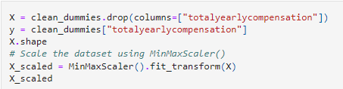
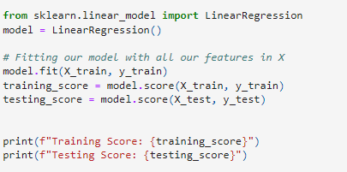
Analysis of Data – Using Liner Regression Machine Learning Model
How was data split into training and testing sets:
Explanation of our model choice
Benefits: Find the relationship between variables (Total Annual Salary vs other factors), to construct a linear equation to observed the data.
Limitations:

Slide 6
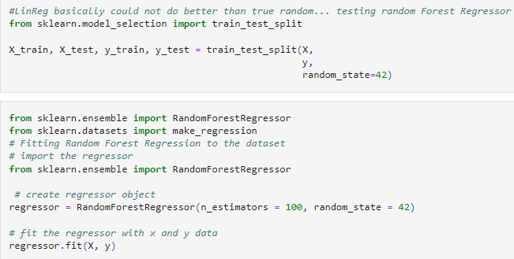
Analysis of Data – Using Random Tree Regressor Machine Learning Model
How was data split into training and testing sets
Explanation of our model choice
Benefits: can solve both regression and classification problems.
limitations

Slide 7
Cross Validation– Using Neural Network Machine Learning Model
How was data split into training and testing sets
Explanation of our model choice
Benefits
limitations

Slide 8
Cross Valdation – Using K-fold Model
How was data split into training and testing sets
Explanation of our model choice
Benefits
limitations

Slide 9
Interactive Dashboard
The tools that will be used to create our dashboard are:
Tools we will use:
Bootstrap
Html
Flask
Tableau to create interactive visuals for the user
GitHub Pages to host

Slide 10
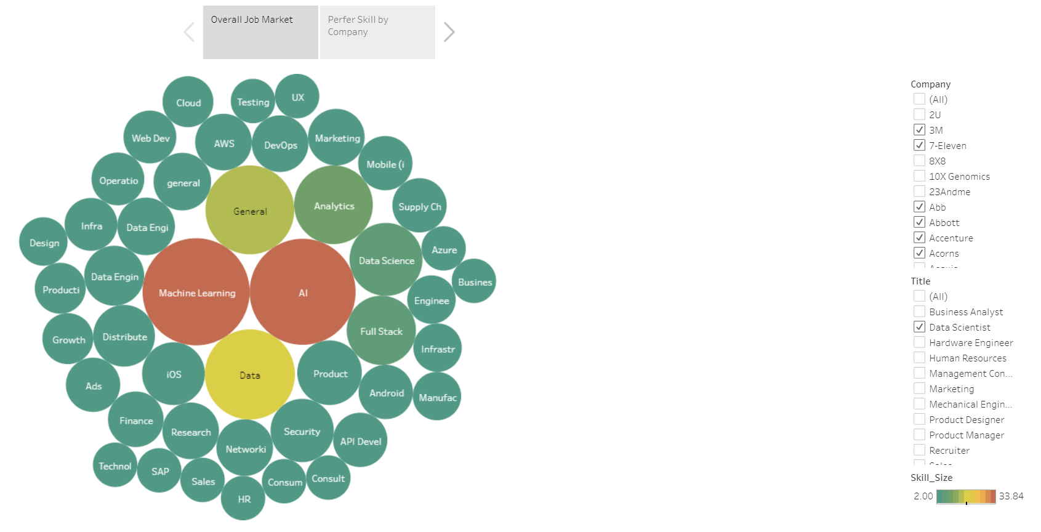
Storyboard: Prefer Skills amount market and different companies
User can filter the titles and companies to see what skills are required or highly acquire by the current employees.
https://public.tableau.com/app/profile/sirius.liao/viz/Preferskillsfordatascientist/Story1

Slide 11
Storyboard: External factors that affect the average salary
Image here
Description of visual and any interactive features

Slide 12
Storyboard: Internal factors that affect the average salary
Image here
Description of visual and any interactive features

